Slide 1
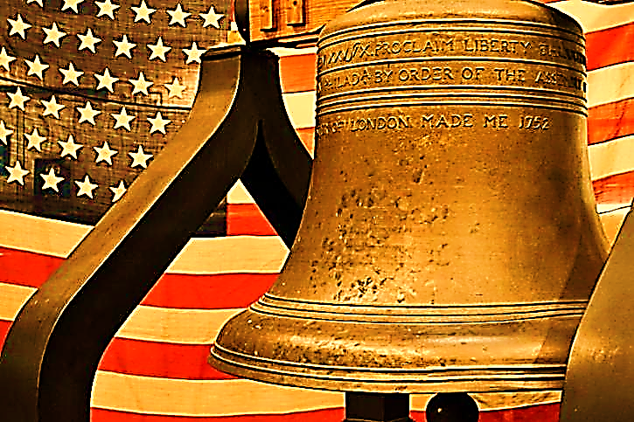
FILM CONFECTIONERY PRODUCTIONS LLC
Capability Statement
Founded in December 2015, Film Confectionery Productions is a Small Business. We specialize in all aspects of video making including Concept Development, Script Writing, Casting, Shot Blocking, Direction, Camera Recording, Cinematography, Photography, Lighting, Editing and Audio/Music Sync.
Core Competency
Past Performance
Concept Development
Script Writing
Casting
Cinematography
Shot Blocking/Direction
Photography
Lighting
Editing/Post-Production
Audio/Music Sync
Rudy’s Mediterranean Grill – Restaurant.
  Completed two Commercials.
Wedding Videos.
  Completed three Separate Wedding videos, to satisfied customers.
Company Snapshot
CAGE: 84ER2 DUNS: 81244400
Key Differentiators
Govt POC: Haider Amin
Phone: 410-718-0314
Email: info@filmcfp.com
Address: 7007 Sandy Spring Rd, MD, 20707
Website: filmconfectionery.com
Our Company has always delivered high quality Videos and content.
We are not Satisfied till we have created a “Great Video”.
We use high quality skills in both Pre-Production and Post-Production.
We use tripods and stabilizers for Steady and Smooth video capture.
Our Key Personnel have an eye for the aesthetic.
We deliver “On point message communication”.
NAICS CODES
512110 : Motion Picture & Video Production.
512191: Teleproduction and other Postproduction Services.
541922: Commercial Photography.
Notes:
FILM CONFECTIONERY PRODUCTIONS LLC
Baskerville

